Slide 1
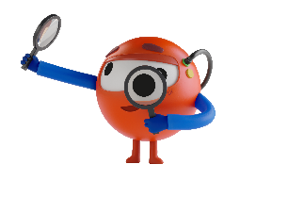
Course Catalog
Last revision: February 2022
Presentation Title
The world’s first online free of charge learning platform to empower people through automation and enable the fully automated enterprise™

Slide 2
The No.1 Automation Learning Platform 300+ free courses in 10 languages 20+ UiPath products covered 1,000,000+ registered users

Slide 3
Contents
Executive Summary
Courses for Business Users and Citizen Developers
Role-based Learning
Slides 4-8
Slides 10-15
Slides 17-29

Slide 4
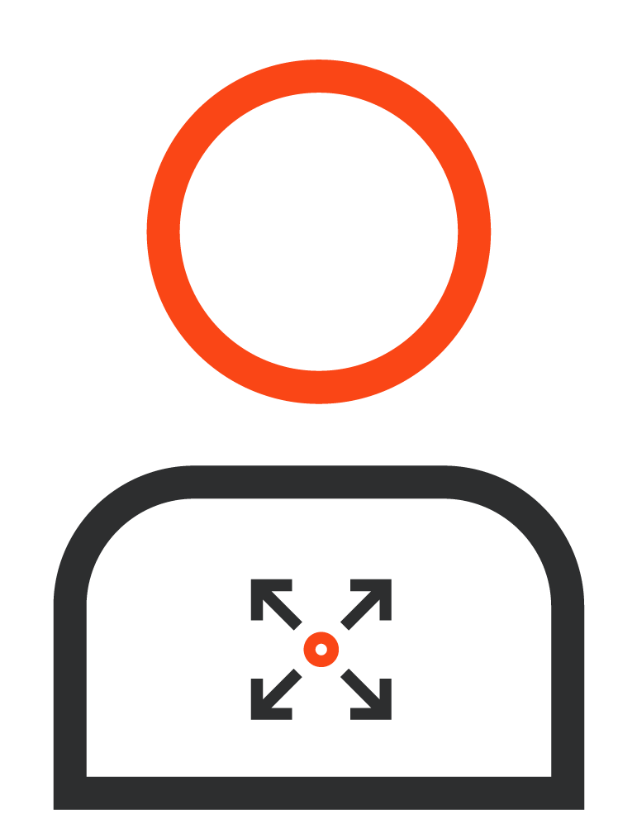
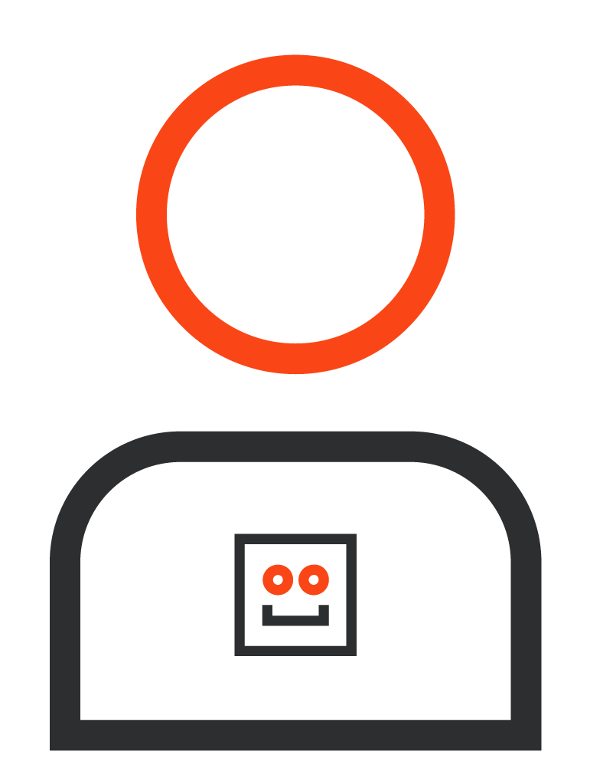
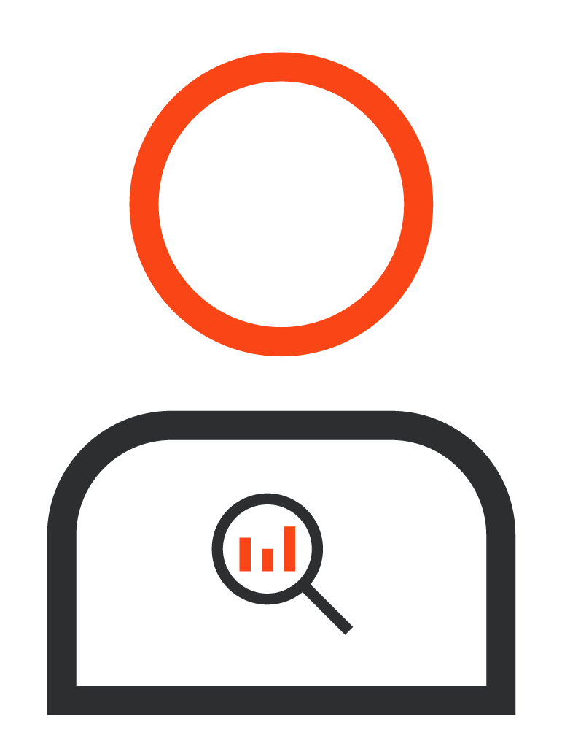
Free, online automation training for all
UiPath Academy provides the means for people to embrace the transformation brought by automation and actively participate in it, no matter their position in the company.
Decision
Makers
Center of Excellence Members
Citizen Developers
Business
Users

Slide 5
Role-based learning
Automation is transforming business. It is creating new roles. It is also changing existing roles by adding automation to the skillset. We have courses for all.
Go to the learning plan
Go to the learning plan
Go to the learning plan
Automation
Developers
Automation
Users
Infrastructure
Engineers
Process
Analysts
RPA Operations Managers
Test
Engineers
Go to the learning plan
Go to the learning plan
Go to the learning plan
Go to the learning plan
Citizen
Developers
RPA Program
Managers
Business
Analysts
Solution
Architects
Project
Managers
Notes:
As companies incorporate automation in their business operations, clear roles are being established. Some of them are traditional roles that just incorporate the automation skillset, such as Business Analysts or Project Managers. Others are completely new, like RPA Developers, RPA Citizen Developers, and so on. Our learning offering is evolving towards mapping the skills needed for these roles, then shifting from a product-centric approach to a role-centric approach, in line with how UiPath’s offering evolves.

Slide 6
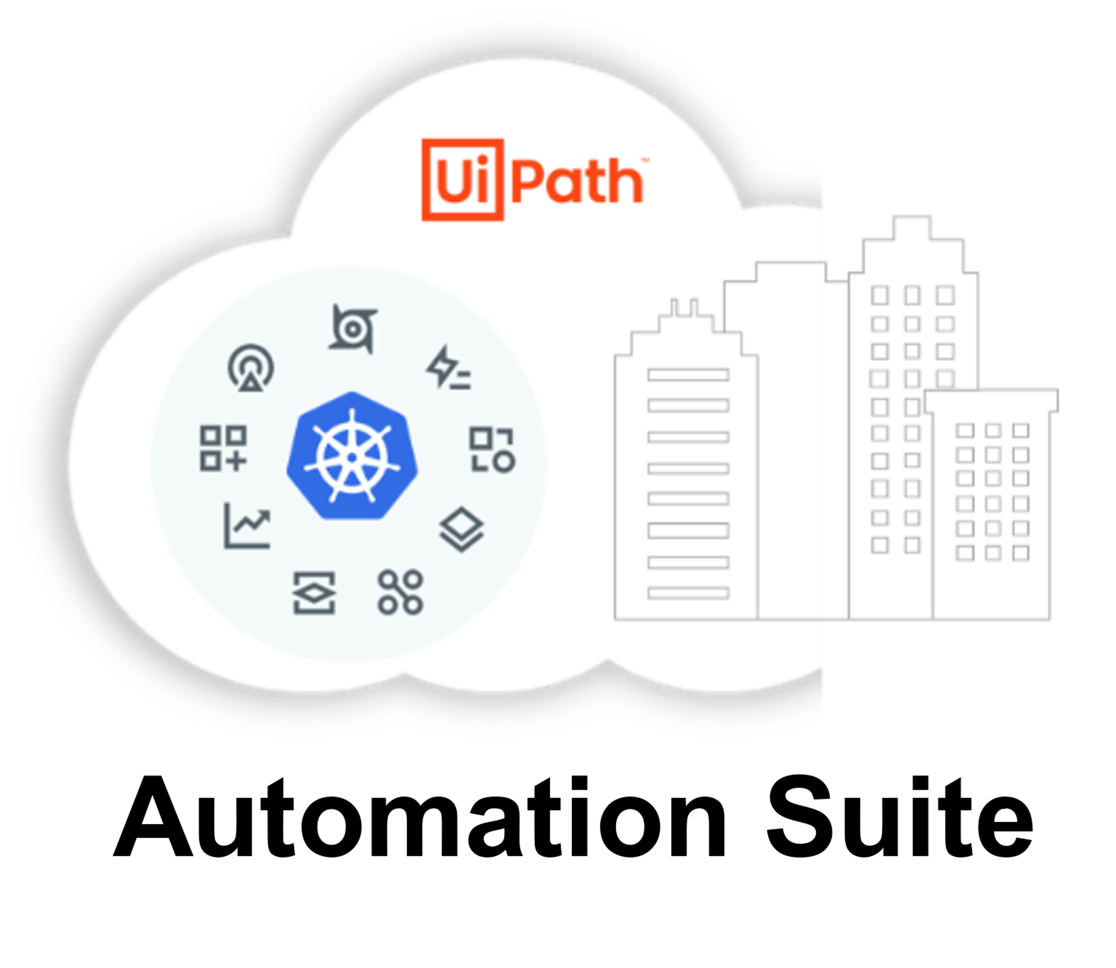
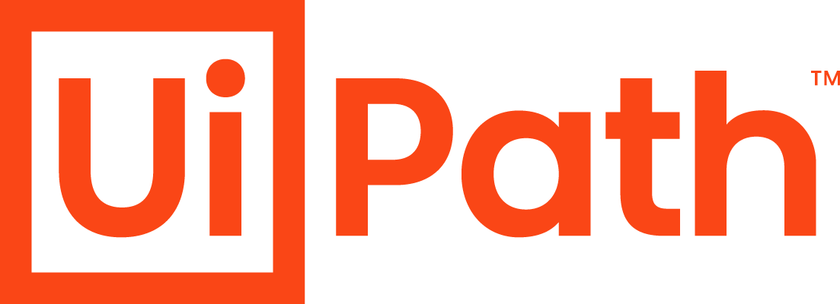
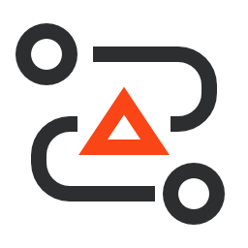
Product-based training
The training you need for the products you want to use
Discover
Build
Manage
Run
Engage
Automation Hub
UiPath Automation Hub Overview course
Task Capture
UiPath Task Capture course
Process Mining
Get Started with UiPath Process Mining course
Task Mining
UiPath Task Mining course
Studio
Get Started with RPA Development course
StudioX
Build Your First Automation with StudioX course
Document Understanding
UiPath Document Understanding Overview course
Automation Ops
UiPath Automation Ops course
Orchestrator
Orchestrator for RPA Developers course
AI Center
UiPath AI Center Overview course
Test Suite
UiPath Test Suite course
Data Service
UiPath Data Service course
UiPath Insights
UiPath Insights course
Robots – Attended and Unattended
Get started with UiPath Robots course
IT Automation
IT Automation course
Integration Service *new*
UiPath Integration Service
course
Apps
UiPath Apps course
Assistant
UiPath Assistant course
Action Center
UiPath Action Center course
UiPath Platform deployment options
Automation Cloud
Automation Suite *new*
Individual products
Notes:
4 years ago we had 3 products – Studio, Orchestrator, and Robots. Now we’re at 20+. Add to that the different ways of accessing and installing the products, and you get the full landscape today. And Academy has been keeping up. No matter if you’ve bought the product and you’re starting to use it or if you’re planning to give it a try, we’re here to support you with comprehensive training.

Slide 7
Learning content in your native language
Chinese * French * German * Japanese * Korean * Portuguese * Russian * Spanish * Turkish
The most consumed courses are available in different languages:
Introduction to RPA and Automation
RPA Citizen Developer Foundation
RPA Developer Foundation and Advanced
RPA Business Analysis Fundamentals

Slide 8
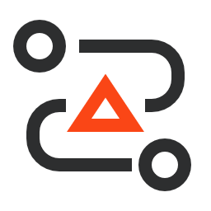
Why
Video-based learning and build-along High-quality videos and downloadable resources, all to encourage learners to build along
Preparing for certification
Dedicated training to prepare for the UiPath Certified Professional exams
Role-based learning plans Learning content tailored to the 10+ personas working with automation
UiPath product training At least one course for each of the 20+ products in the UiPath Platform
Available in multiple languages The most important courses available in 10+ languages
Notes:
UiPath Academy started in April 2017. It was the first free learning platform in the automation space. Back then, UiPath meant 3 products covering what we call today core RPA: automating simple tasks using the UI layer of applications. Since then we've grown as a company – we have many more products to automate all the business facets. We've added AI, process mining, test automation.
The industry itself has evolved. Roles have been established, the most important one being the RPA Developer, with the job demand growing in double digits every year. UiPath Academy helps people prepare for taking the certification exams.
Just like in Day 1, we're committed to offering free and universal learning. Back then it was for core RPA, now it’s for the entire automation spectrum. This is fully aligned with UiPath's mission of accelerating human achievement, by making automation a reality for as many people as possible. And what can be more ambitious than supporting people to take the driver's seat when dealing with automation? To deliver on this, there’s an entire ecosystem built around UiPath Academy, with free access to the Community edition of our product, a free Forum, a free Marketplace and so on.

Slide 9
Courses for Business Users and Citizen Developers

Slide 10
RPA Starter
Where the journey begins
If you’re new to RPA and automation, this is the best place to start, no matter the type of work you do.
Ramp up quickly with the basic concepts, then get a hands-on, assisted experience of building your first automation with UiPath StudioX, our tool for business users.
Educate everybody with the RPA Starter plan, made of 2 courses:
Introduction to RPA and Automation
Build Your First Automation with StudioX

Slide 11
Introduction to RPA and Automation
This automation basics course is your entry into the world of RPA and automation.
It is an introduction to RPA, answering “Why is everybody talking about RPA and automation?” and “Why UiPath?”.
Duration: 1 hour
Access the course here

Slide 12
Build Your First Automation with StudioX
Once you get a grasp of RPA, automation and the associated concepts, it’s time to get practical.
Experience building an automation with this step-by-step course on StudioX, our automation tool for business users. No coding experience needed!
Apart from demonstrating what’s really like to build an automation, this course is a bridge towards the RPA Citizen Developer, our learning plan meant to enable you to automate your work with StudioX.
Duration: 2.5 hours
Access the course here

Slide 13
Courses for Business Users
Depending on how you engage with robots and the products you use, we have a bunch of courses to get you fully up to speed:
Do you have UiPath Assistant installed and use it to start automations relevant to your work? Check out the UiPath Assistant course!
Are you starting automated processes with robots which are not on your machine? Are you validating their work? For either of the two, check out the UiPath Action Center course!
Are you engaging with the automation program in your company by proposing processes and tasks to be automated and helping them become a reality? Enroll in the UiPath Automation Hub Overview course.

Slide 14
RPA Citizen Developer Profile and learning journey
This learning plan is designed for business users looking to develop the technical skills to automate their work and other simple business processes with a dedicated tool: UiPath StudioX.
The plan starts with an introductory course in which the main capabilities of StudioX are previewed, then continues with a dedicated course on user interface automation, which is specific to RPA. It then goes on with dedicated courses to cover the automation capabilities of StudioX for the most common tools and technologies that a business user is expected to interact with (e.g., Word, Excel, Gmail). The last course in the plan is entirely practical and meant to bring together the automation skills acquired with universal business use cases.
Check out the next slide for the full structure and link!

Slide 15
RPA Citizen Developer Foundation Learning plan structure and essential information
Get Started with StudioX
User Interface Automation with StudioX
Word Automation with StudioX
Decisions, Iterations and Scenarios in StudioX
Error Handling in StudioX
File and Folder Automation with StudioX
Working with Data in StudioX
Email Automation with StudioX
Excel Automation with StudioX
PowerPoint Automation with StudioX
Running StudioX Automations
Virtual Automation Bootcamp with StudioX
Prerequisites: no formal prerequisites, other than the drive to evolve from a technical standpoint.
Duration: 15.5 hours
Fully localized in: French, Turkish, Chinese, Spanish, German and Korean
Multilingual closed captioning support for: Japanese, Portuguese
Access the learning plan here
Remember! All the courses can be taken through the learning plans they are included in, as well as individually.

Slide 16
Role-based Learning
On the path to fully automated enterprises, companies need their own self-sustaining and scalable expertise for discovering, developing and managing automations.
That expertise takes the shape of a Center of Excellence. Discover the persona-based learning offering to set up a Center of Excellence and enable the critical roles!

Slide 17
Automation Developer Profile and learning journey
What do they do?
Automation Developers are the engine of every automation program. They transform the automation opportunities to reality by building enterprise-scale automations.
They are doing it through a combination of technical skills and business acumen, with UiPath Studio and the other components of the UiPath Platform.
What’s their learning journey?
It starts with RPA Developer Foundation, at the end of which they can build components of enterprise-scale automations. They can also take the RPA Associate certification exam.
They continue with the RPA Developer Advanced to be fully equipped to autonomously develop end-to-end enterprise automations. They can also take the Advanced RPA Developer certification exam.
Then they can continuously learn new skills and technologies from the other courses available on UiPath Academy.

Slide 18
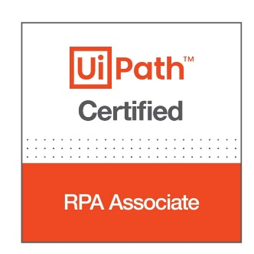
RPA Developer Foundation Learning plan structure and essential information
Get Started with RPA Development
A Day in the Life of an RPA Developer
Variables, Arguments and Control Flow
UI Automation with Studio
DataTables and Excel Automation
Selectors
in Studio
Project Organization
Debugging in Studio
Error and Exception Handling
Introduction to Logging in Studio
Orchestrator for RPA Developers
Email Automation with Studio
PDF Automation
with Studio
Version Control System Integration
RPA Testing with Studio Pro
Prerequisites: basic programming skills from any language
Duration: 36 hours
Access the learning plan here
Remember! All the courses can be taken through the learning plans they are included in, as well as individually.

Slide 19
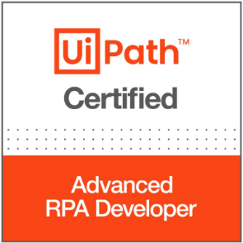
RPA Developer Advanced Learning plan structure and essential information
State Machines in Studio
Activity Project Settings in Studio
Introduction to Robotic Enterprise Framework
Build a ReFramework with Orchestrator Queues
Build a ReFramework with Tabular Data
Practice with ReFramework
Attended Automation Features in Studio
Invoke Method and Invoke Code
Workflow Analyzer in Studio
Prerequisites: RPA development expertise with UiPath Studio and the other components of the UiPath Platform
Duration: 38 hours
Access the learning plan here
Remember! All the courses can be taken through the learning plans they are included in, as well as individually.

Slide 20
RPA Developer Continuous Learning
UiPath Academy offers plenty of opportunities for continuous learning for RPA Developers. These may be new technologies that RPA Developers face in new automation scenarios, new products and features to tackle new opportunities for automation or better ways of automating existing scenarios. For the full list of relevant courses, use the filters on the Courses page!
There is so much value in having a personal assistant to take over the tasks which can be automated. Learn how to put all the attended features to work with the Attended Automation for RPA Developers course!
RPA development deals so much with UI elements, so there had to be a way of reusing them across automations. Check out this course on Object Repositories, the UiPath libraries of UI elements.
As an RPA Developer, there’s a high chance you will need to work with SAP. And we have the right resource for that: the SAP Automation with Studio course.
Sometimes, RPA automations require user interfaces, so that human users interacting with them will have the best experience. In those cases, UiPath Apps may be of great help. Find out how from the dedicated course!
UiPath Integration Service is the component of the UiPath Platform meant to help you combine API automation with UI automation. And here’s the dedicated course!
End-to-end process automation is now possible with the help of orchestration process and UiPath Action Center. Find out how to put them to work from this course!
Automations in Linux? Why not? With UiPath Studio, you are able to build, run and manage automations for Linux. Check out this course to find out how!
There’s an easier way to automate processes using Chrome through WebDriver. And we have a course to explain how to do it!

Slide 21
RPA Solution Architect Profile and learning journey
What do they do?
RPA Solution Architects are the ones defining the architecture of an automation solution and choosing the technology stack for the development and operationalization of the solution. Moreover, they are the ones overseeing the development and implementation stages.
What’s their learning journey?
Since they have to be familiar with all the RPA development capabilities, they need to go through the courses from both RPA Developer Foundation and RPA Developer Advanced.
After that, they are ready for the role-based introductory course: RPA Solution Architecture Fundamentals.
Then they need to become familiar with some of the other features and components of the UiPath Platform which may be relevant to their role: e.g., UiPath Test Suite, Orchestration Process.

Slide 22
RPA Solution Architect Foundation Learning plan structure and essential information
RPA Developer Foundation courses
RPA Developer Advanced courses
RPA Solution Architecture Fundamentals
UiPath
Security
Orchestration
Process
UiPath
Test Suite
Prerequisites: Moderate experience as a Solution Architect or extended experience as a senior RPA Developer
Duration: 74 hours
Access the learning plan here
Remember! All the courses can be taken through the learning plans they are included in, as well as individually.

Slide 23
RPA Infrastructure Engineer Profile and learning journey
What do they do?
The Infrastructure Engineer is a well-established role with a continuously evolving skillset. When companies adopt automation, there are countless ways to combine the products and deploy them: in cloud, hybrid, on-premises, and so on.
RPA Infrastructure Engineers have to be able to manage all the complexities of the infrastructure of the automation solutions.
What’s their learning journey?
Start with the Introduction to RPA and Automation course.
Learn the basics of the infrastructure needs of the UiPath Platform, with a focus on the RPA core components, with the RPA Infrastructure Fundamentals course.
Get an overview of UiPath Automation Suite, the easiest way to deploy the entire UiPath Platform on-premises or public cloud from the UiPath Automation Suite Overview course.
Find out how to install Automation Suite from the UiPath Automation Suite Installation course.
Access the Foundation learning plan here

Slide 24
RPA Business Analyst Profile and learning journey
What do they do?
Business Analysts are key in digital transformation programs, with their role of defining needs and recommending solutions.
With the automation business analysis skillset added, they can deliver value to the stakeholders by better understanding automation opportunities and proposing the right solutions.
What’s their learning journey?
Start with the Introduction to RPA and Automation course.
Learn the basics of RPA business analysis from the RPA Business Analysis Fundamentals course.
Access the Foundation learning plan here
What UiPath products can they use?
UiPath Automation Hub to manage the program.
UiPath Task Capture to document the as-is process.
UiPath Task Mining to discover new opportunities.
UiPath Process Mining to discover new opportunities.
UiPath Insights to measure impact of the the program.

Slide 25
RPA Project Manager Profile and learning journey
What do they do?
Everybody knows the main role of Project Managers in leading the team in charge of the change implementation.
And while the automation skillset is not mandatory, it’s highly beneficial, given the constant presence of RPA and automation in digital transformation programs.
What’s their learning journey?
Start with the Introduction to RPA and Automation course.
Find out how a typical RPA project is managed from the RPA Implementation Methodology Fundamentals course.
Access the Foundation learning plan here
What UiPath products can they use?
Introduction to Automation Operating Model
Automation Operating Model Foundations (virtual instructor-led training)
UiPath Automation Hub Overview
UiPath Automation Hub Deep Dive.

Slide 26
Process Mining Analyst (new) Profile and learning journey
What do they do?
Process Analysts are relatively new in organizations. Their role is to use scientific methods applied to large amounts of data to discover ways of optimizing processes, including through automation.
They do scientific discovery using tools like Process Mining and even Task Mining.
What’s their learning journey?
Find out about the scientific discovery and the dedicated tools from the Get Started with UiPath Process Mining course.
Go through the basics of analysis with the Process Analysis Fundamentals course.
Advance to the next level of process analysis with the Process Analysis Advanced course.
Access the Foundation learning plan here

Slide 27
RPA Operations Manager Profile and learning journey
What do they do?
In large-scale deployments, companies need professionals whose main responsibilities revolve around the management of the robot workforce and the automations.
These are the RPA Operations Managers. They use Orchestrator, Insights and even Automation Ops to monitor the health and performance of the automation environments and make the right interventions.
What’s their learning journey?
Start with the Introduction to RPA and Automation course.
Get familiar with the main capabilities of UiPath Orchestrator from the Orchestrator for RPA Developers course.
Learn how to use the analytics solution included in the UiPath Platform from the UiPath Insights course.
Find out about the governance capabilities of the UiPath Platform from the UiPath Automation Ops course.

Slide 28
Test Engineer Profile and learning journey
What do they do?
Every company out there is in the software business. Software development requires testing. With their responsibility in quality assurance, Test Engineers are becoming more and more important. And in order to become more effective, they also need to add automation to their skillset.
UiPath Test Suite is meant to address all the needs of Test Engineers for software testing: application testing, RPA testing and even mobile device testing.
What’s their learning journey?
Get an overview of the solution with the UiPath Test Suite course.
Find out why RPA Testing becomes more and more important and how you can put UiPath Test Suite at work for it.
Have a tour of all the capabilities of UiPath Test Suite for application testing from the Application Testing course.
Learn how UiPath Test Suite can be used to automate every action in SAP with the SAP Automation course.
Manage test projects with UiPath Test Manager.

Slide 29
Automation Program Manager Profile and learning journey
What do they do?
Companies committed to put automation at the core of their digital transformation program need the right person to manage the entire automation program, as well as the structure in charge of implementing it: the Automation Center of Excellence.
What’s their learning journey?
Start with the Introduction to RPA and Automation course.
Find out everything about UiPath Automation Hub, our tool for managing the automation program, from the two incremental courses: the Overview course and the Deep Dive course.
Learn how to set up the Automation Operating Model in your company from the AOM Foundations virtual training.
Establish a plan to have all the roles in the organization ready for the new ways of working with the Up-skilling Teams with an RPA Organizational Development Plan course.
Find out about the Robot for Every Person framework to make automation a reality for everyone from the dedicated course.
Learn how to measure your automation program with the UiPath Insights course.

Slide 30
Thank You
Register on academy.uipath.com today.
UiPath Confidential and Proprietary. UiPath and UiPath Partner Internal Use Only.
© UiPath, Inc. All rights reserved. Information herein is subject to change without notice.

Slide 31
Safe Harbor
This presentation may include forward-looking statements. Forward looking statements include all statements that are not historical facts, and in some cases, can be identified by terms such as “anticipate,” “believe,” “estimate,” “expect,” “intend,” “may,” “might,” “plan,” “project,” “will,” “would,” “should,” “could,” “can,” “predict,” “potential,” “continue,” or the negative of these terms, and similar expressions that concern our expectations, strategy, plans or intentions. By their nature, these statements are subject to numerous risks and uncertainties, including factors beyond our control, that could cause actual results, performance or achievement to differ materially and adversely from those anticipated or implied in the statements. Although our management believes that the expectations reflected in our statements are reasonable, we cannot guarantee that the future results, levels of activity, performance or events and circumstances described in the forward-looking statements will be achieved or occur. Recipients are cautioned not to place undue reliance on these forward-looking statements, which speak only as of the date such statements are made and should not be construed as statements of fact.
This meeting is strictly confidential. By participating in this meeting, you agree to keep any information we provide confidential and not to disclose any of the information to any other parties without our prior express written permission. Neither the information contained in this presentation, nor any further information made available by us or any of our affiliates or employees, directors, representatives, officers, agents or advisers in connection with this presentation will form the basis of or be construed as a contract or any other legal obligation.

